Slide 1



DATABASE MANAGEMENT SYSTEMS
DBMS

Slide 2

ONLINE SPORTS BOOKING AND TOURNAMENT (MANAGEMENT) SYSTEM
BY
A.ANIRUDH - (2110030289)
P.SANTHOSH - (2110030392)
K.PRASHANTH - (2110030334)
V.AKSHAY - (2110030246)
UNDER THE GUIDANCE OF
(SUMIT HAZRA)

Slide 3
PROBLEM STATEMENT AND DOMAIN
We have come here with “Online sports and Management system”.
Players can’t find tournaments before hand.
Venue owners not being able to make their stadium reach players.
Player’s without team are not able to find teams to join.
Teams not being able to find tournament.
Tournament owners not getting enough venues & teams.

Slide 4
EXISITING SOLUTIONS
Manages the selection activity of students to college and to state level.
Here the users will consume less amount of time when compared to manual paper work through the automated system.
Used to improve the problems existing in the management ,realize the regular and handle the affairs of sports efficiently.
Sports management system is an objective which is developing according to the sports management situation.

Slide 5
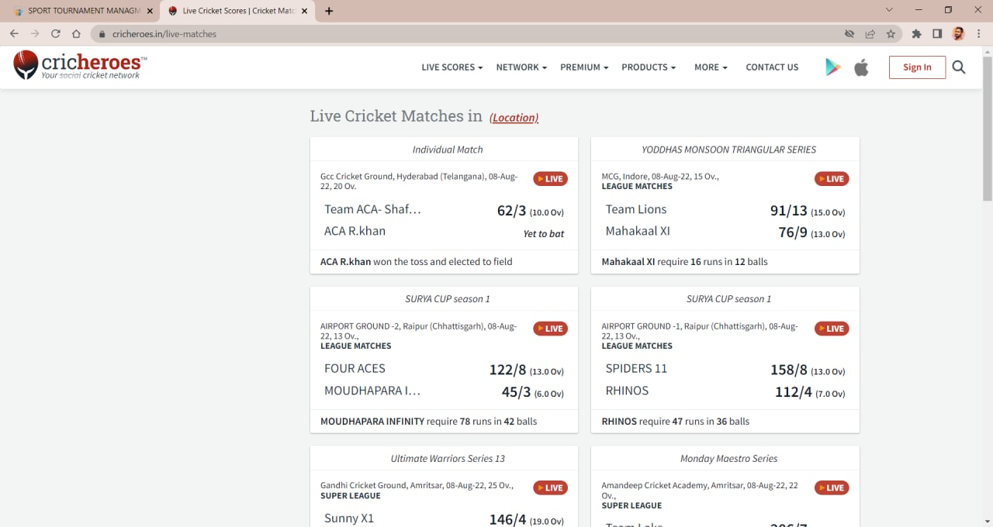
ALREADY EXISTING:

Slide 6
PROPOSED ALGORITHM DESIGN TECHNIQUE
It contains user AUTH features for login/register and a user dashboard for viewing all the events and registering to them.
Online Sports Management system is a full stack Django Web Application which provides a clean, informative and interactive user interface to see and register for sports club events.
It contains responsive pages and tabs to add view, manage and enroll in different types of sports events.

Slide 7
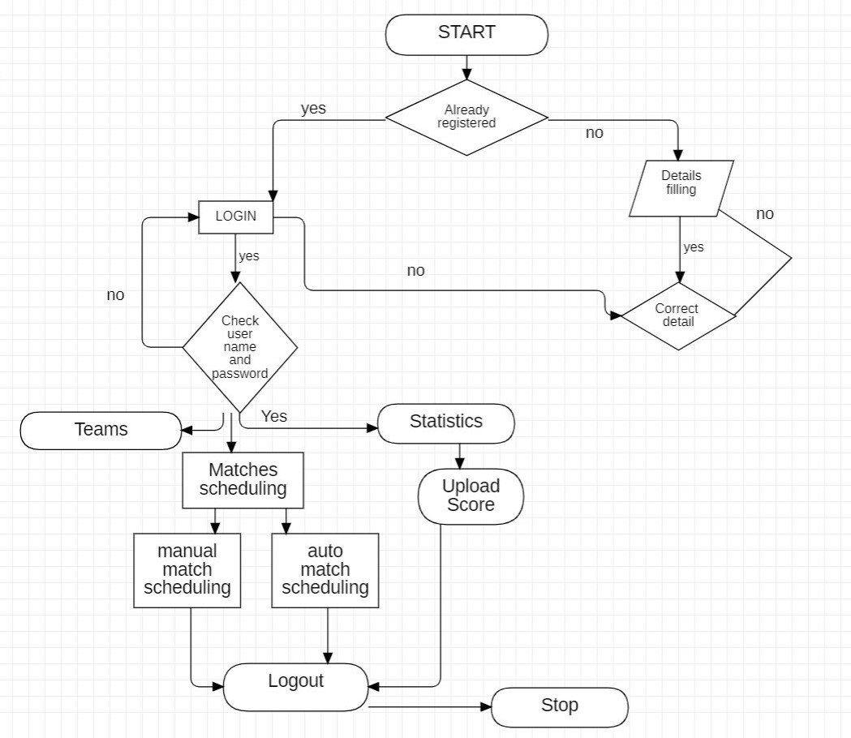
FLOW DIAGRAM

Slide 8
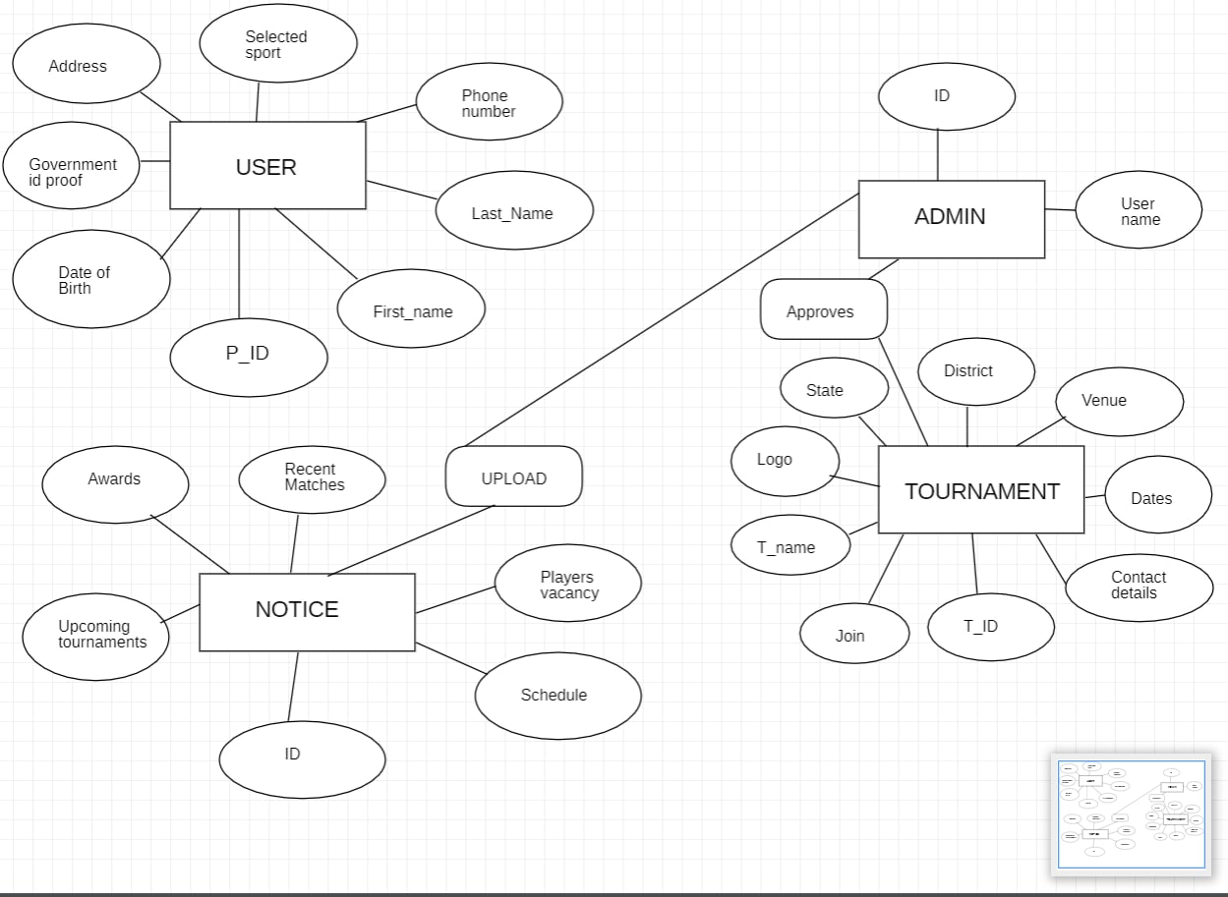
ER DIAGRAM

Slide 9

DATA STRUCTURES NEEDED
LIST.
ARRAYS.
MYSQL
HTML,CSS
Python Django framework
……………..

Slide 10
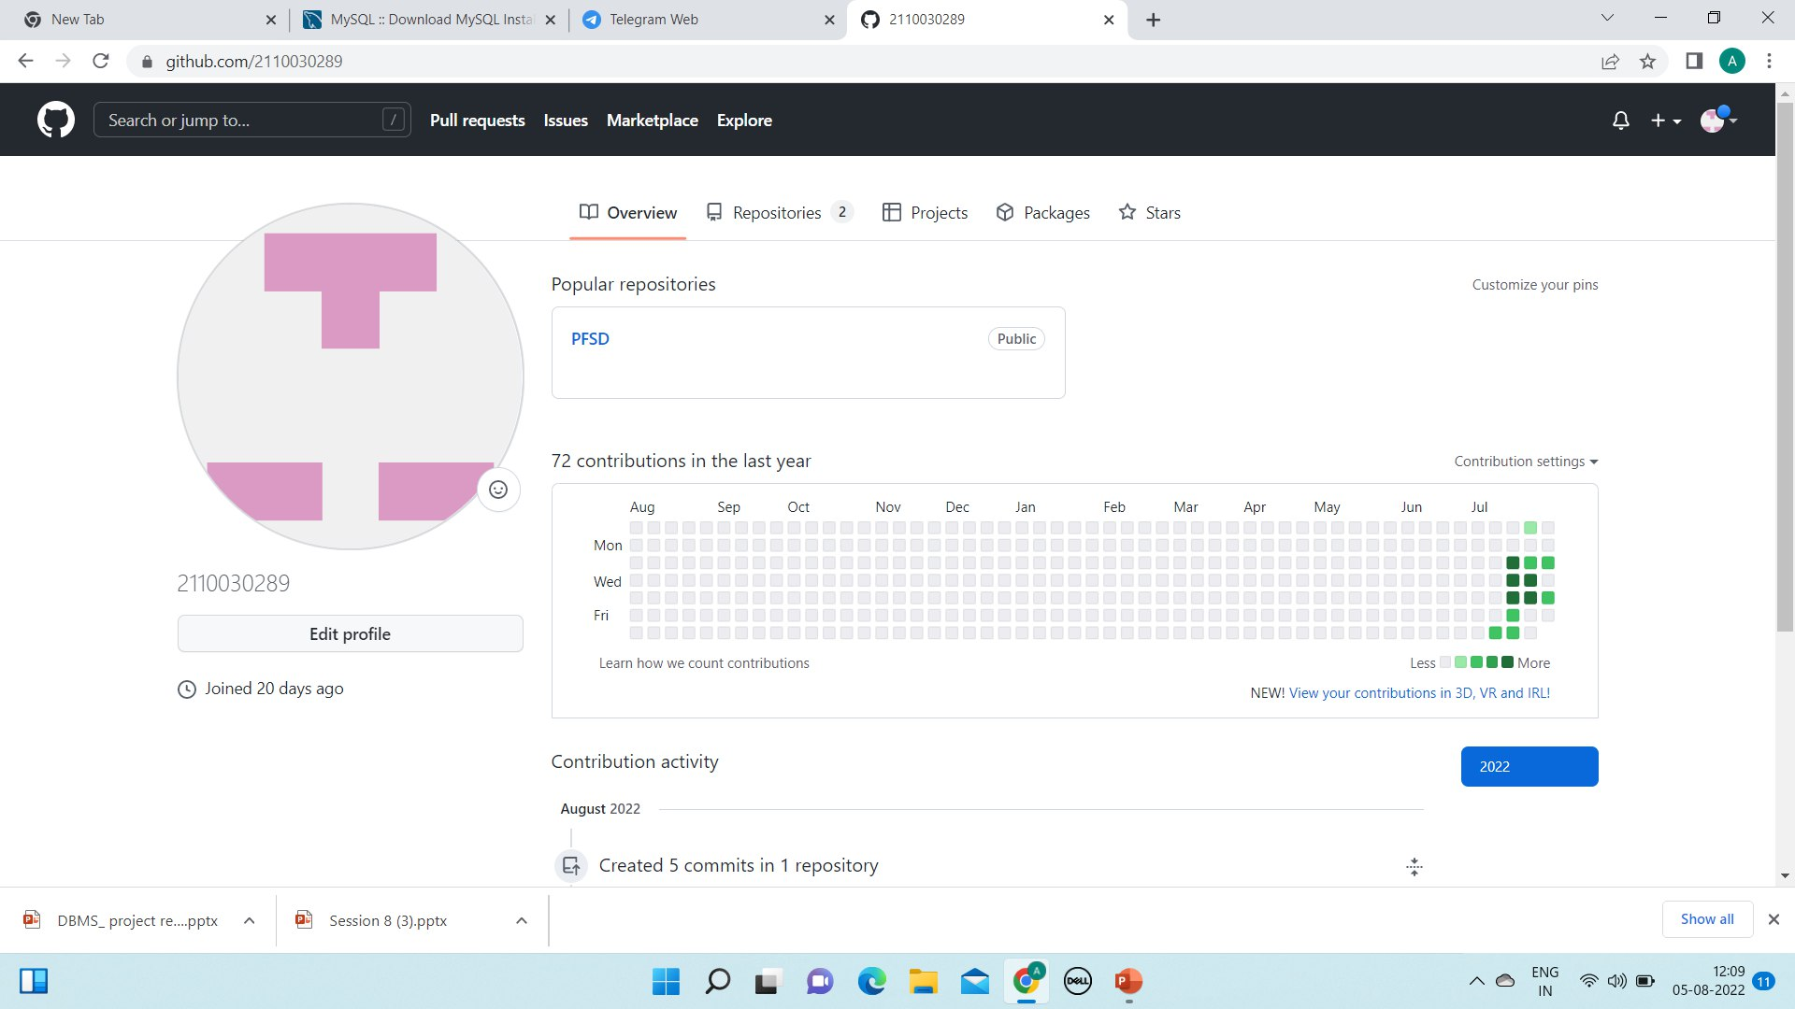
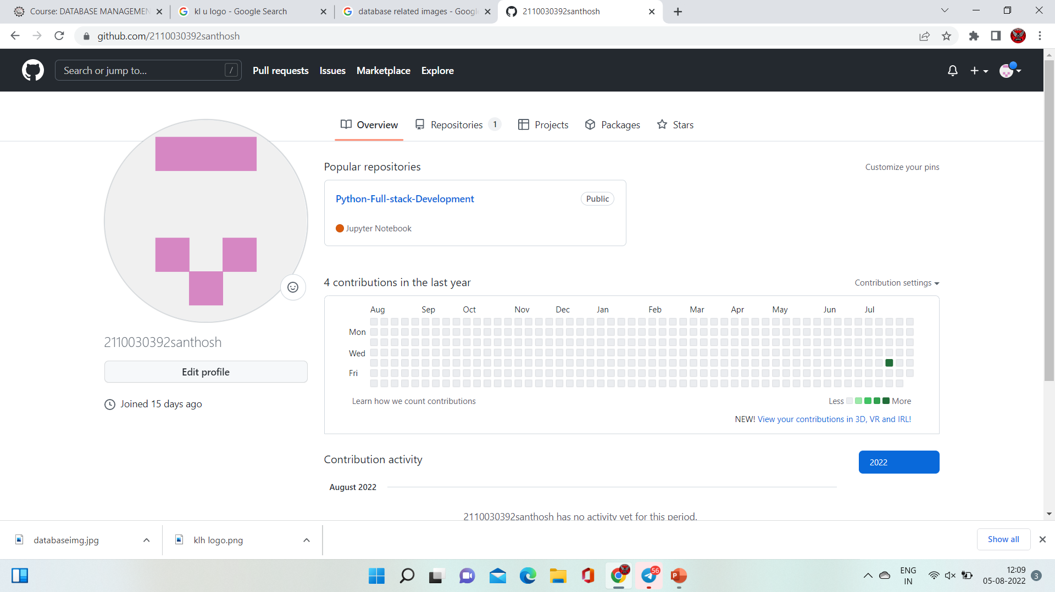

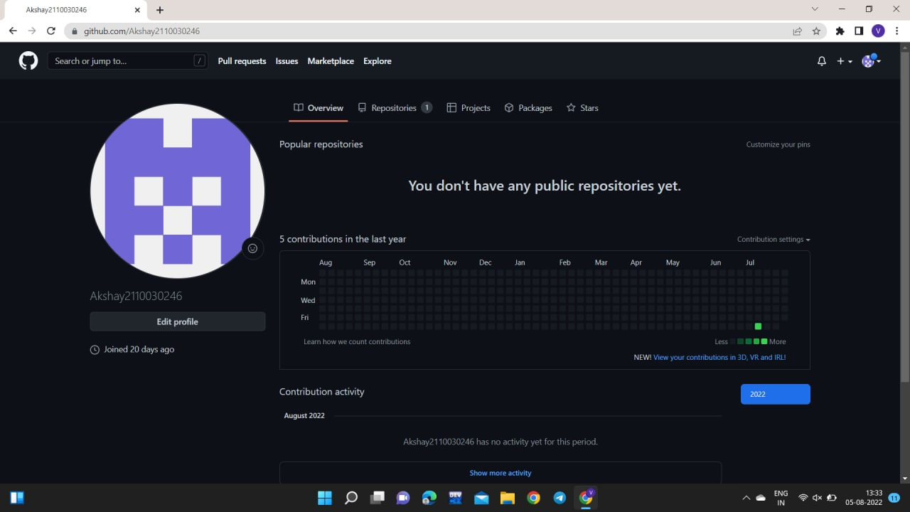
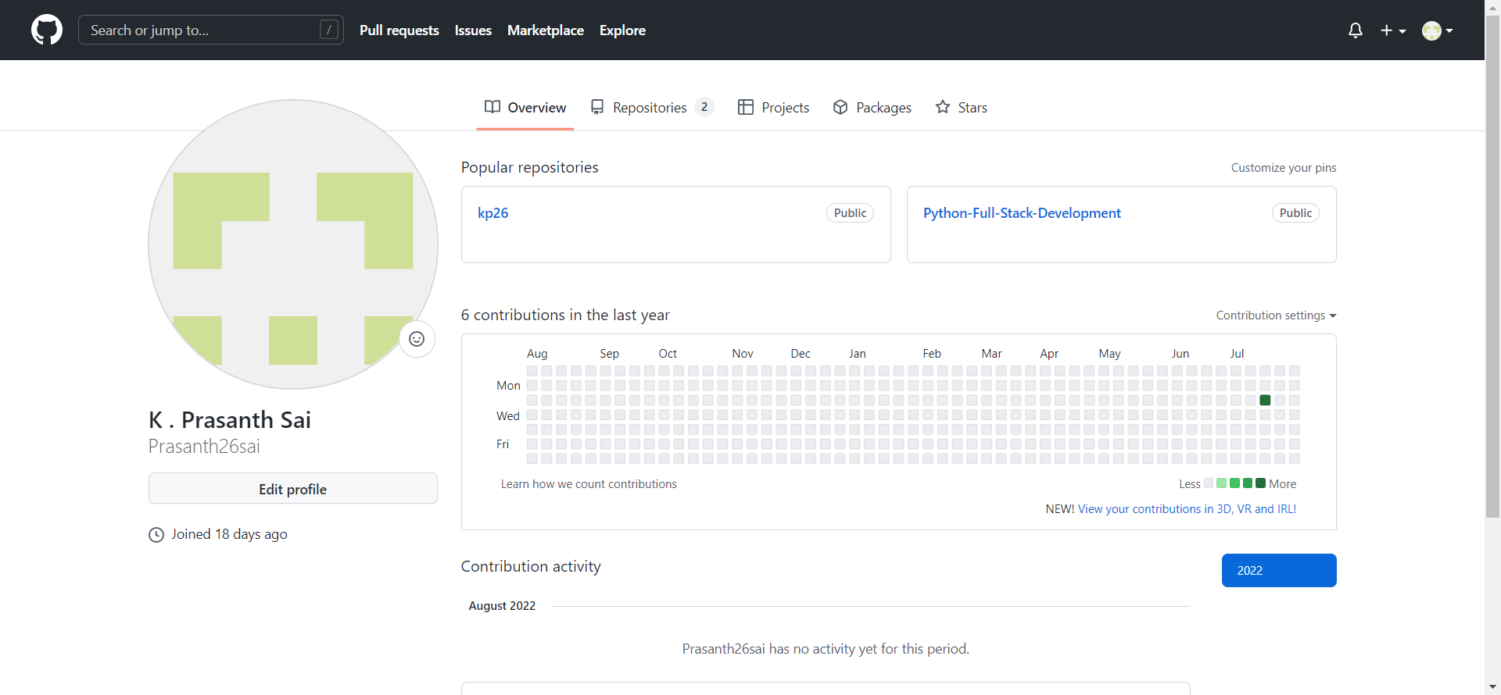
GITHUB SETUP

Slide 11
LINKS
https://github.com/2110030392santhosh
https://github.com/2110030289
https://github.com/Prasanth26sai
https://github.com/Akshay2110030246

Slide 12
DIVISION OF WORK AMONG GROUP MEMBERS
A.ANIRUDH (2110030289) _ CODE(PYTHON), PROJECT STUDY
P.SANTHOSH(2110030392) – TEMPLATE,CLASS DIAGRAM
K.PRASHANTH(2110030334) _ ER DIAGRAM,WEB PAGE CREATION, PROJECT STUDY
V.AKSHAY(2110030246) _ MYSQL, HTML

Slide 13

Thank you

